Slide 1
Grace Bible Church Glorifying God by Making Disciples of Jesus Christ

Slide 3
Grace Bible Church Glorifying God by Making Disciples of Jesus Christ

Slide 4
No Greater Love Selected Scriptures
National observance dates to 1868 and G.A.R. General Logan’s designation of May 30 to decorate graves
There are conflicting claims to the location and date of the first observance of a Memorial Day

Slide 5
No Greater Love Selected Scriptures
The Federal government declared Waterloo, NY, May 5, 1865 as the birthplace -
but truth belongs to God
The purpose of Memorial Day has expanded over the years to include all wars, emergency service personnel

Slide 6
The Importance Remembering
It is up to each generation to teach the next generation its history or it will lose its future

Slide 7
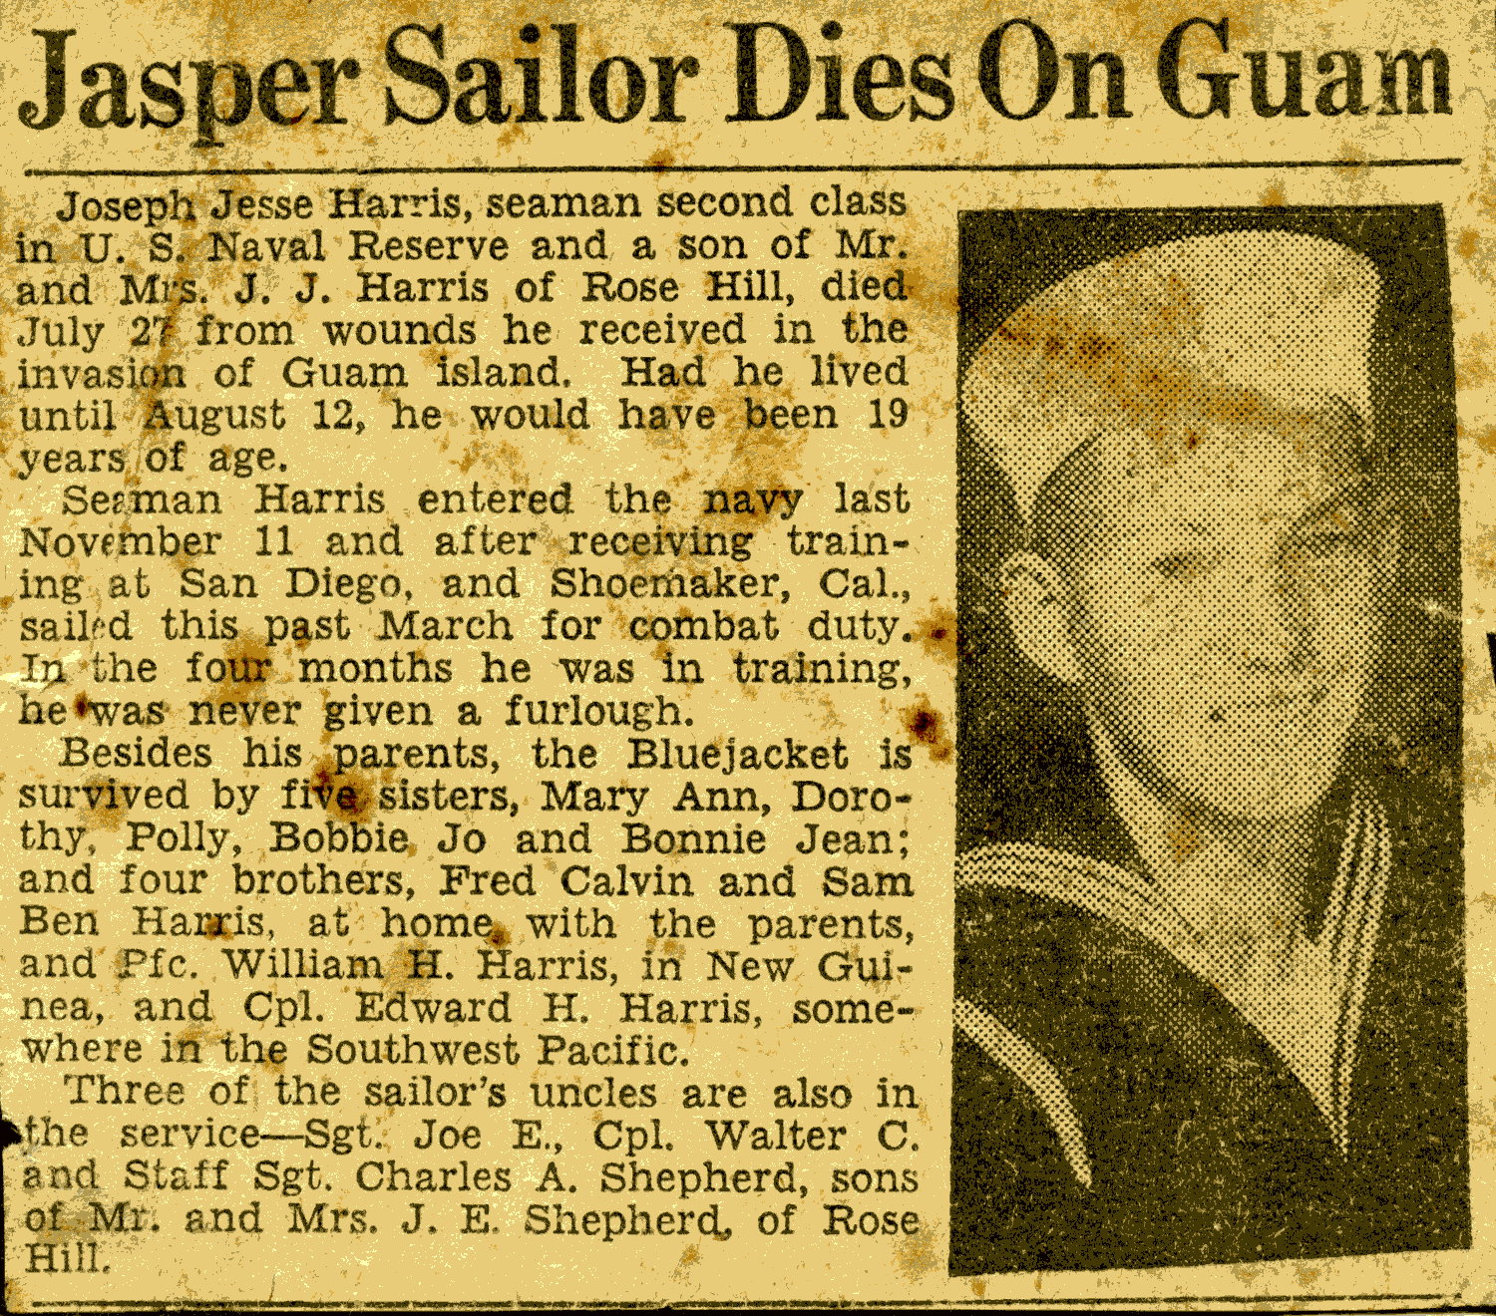
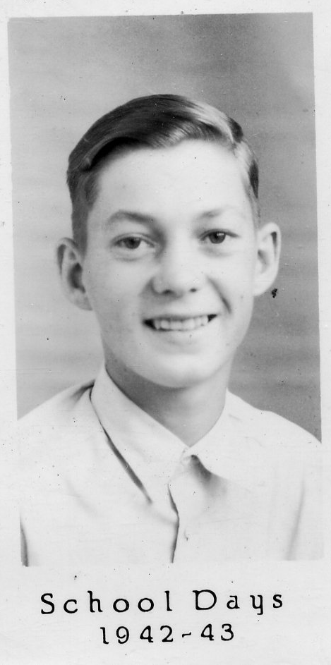

Slide 8
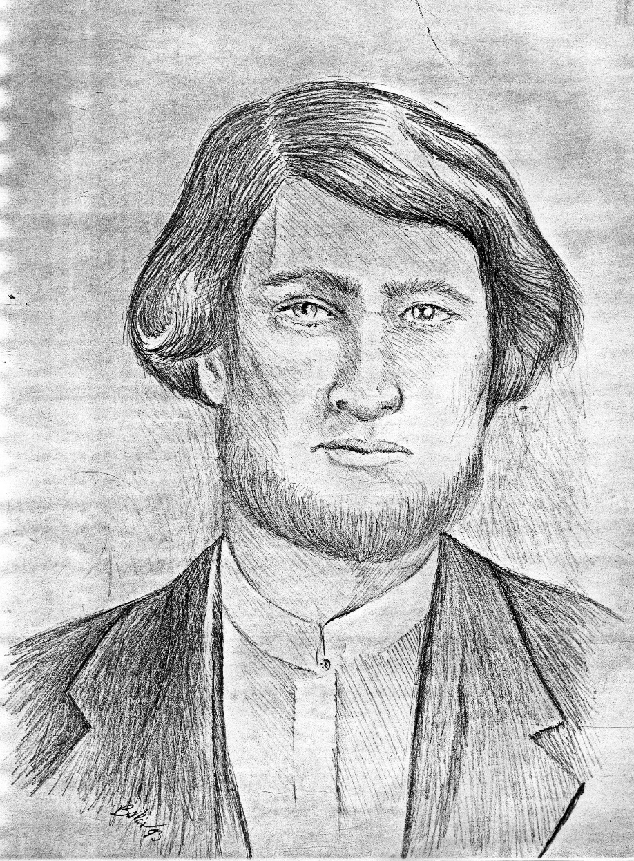
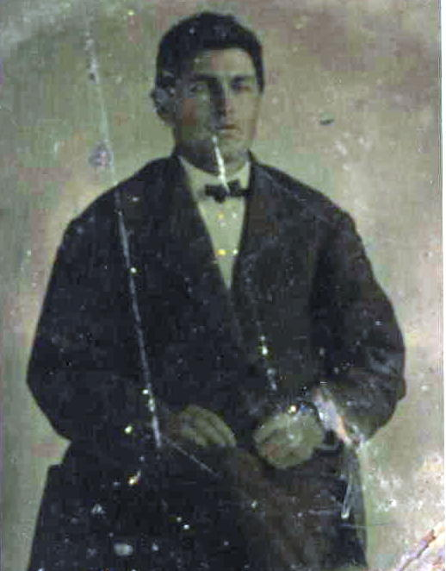

Slide 9
The Importance Remembering
We all share in the heritage of:
667,000 + who died in battle
674,000 + who died of other causes
1,500,000 + wounded
40,000+ missing
Failure to remember & honor them will result in failure to preserve the causes for which they died

Slide 10
The Importance Remembering
Taking time to remember is part of worship & a reminder of God’s providential hand in history & future

Slide 11
Memorials in Scripture
The Rainbow established as the sign of God’s covenant to never destroy the earth again by flood (Gen. 9)
Passover established as a yearly reminder of God’s hand in the Exodus (Exodus 12-13)
The 12 stones set up as a memorial to God enabling them to cross the Jordan on dry ground (Joshua 3-4)

Slide 12
Memorials in Scripture
The book of Esther records the origin of the Feast of Purim - a yearly reminder of God’s mercy
Graves and monuments were reminders of those who had died and their importance

Slide 13
Memorials in Scripture
Psalms and books were written as reminders and memorials
Communion is a ceremony of memorial of Jesus’ death and promise of return (1 Corinthians 11)

Slide 14
Reasons to Remember & Honor
Nationally - to remember & honor those who have died & encourage diligence to maintain our freedoms
To remember & honor the origin of our nation in the men who fought against England’s oppression
To remember & honor our ancestors and relatives

Slide 15
Reasons to Remember & Honor
To remember & honor men of integrity who fulfilled the responsibilities placed upon them
To remember & honor those who have sought to provide or protect freedom of foreign peoples
To remember those who died in battle as well as the 45% that died from other causes

Slide 16
Reasons to Remember & Honor
To remember those that died trying to protect their buddies and other men in their unit
John 15:13 - " Greater love has no one than this, that one lay down his life for his friends.”
Jesus’ statement is a tautology, a proverbial statement of self evident truth.

Slide 17
Reasons to Remember & Honor
The response toward someone who has made sacrifice on your behalf is extreme gratitude
We remember & honor those who have died and with gratefulness acknowledge the benefits they gave us

Slide 18
The Greatest Love
John 15:14-17 –
A wondrous statement that Jesus, the son of God, would say this to mere humans
Romans 5:7 -
Romans 5:8 - The greatest love ever demonstrated

Slide 19
The Greatest Love
Sin is missing the mark of God’s perfect will - it is also hatred against God and His just commands
Jesus fulfilled the law & paid the price of sin by His own death on the cross
Man cannot escape God’s condemnation by any effort of His own - Rom. 6:23; Isa. 64:6; Heb. 10:4

Slide 20
The Greatest Love
Forgiveness & reconciliation with God is offered to all that will believe in the Lord Jesus Christ
He who has the Son has eternal life; those that do not believe remain condemned (John 3:16-21)
We honor all those who have died on our behalf, but especially the Lord Jesus Christ

Slide 21
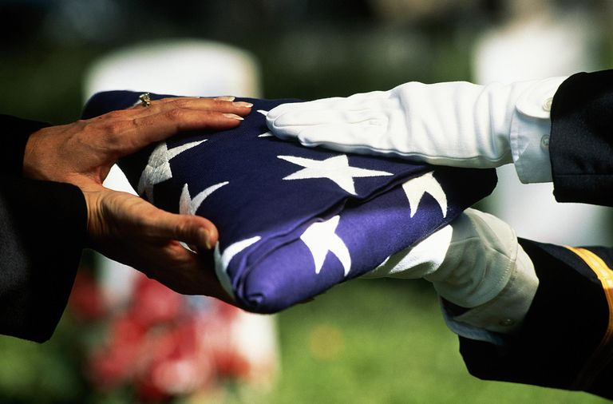

Slide 22
God Bless America
God bless America,
Land that I love,
Composer © Copyright Info
ARR UBP – CCLI License No. 378119

Slide 23
Stand beside her and guide her
Thru the night with a light from above;

Slide 24
From the mountains,
to the prairies,
To the oceans white with foam,

Slide 25
God bless America,
My home, sweet home.
God bless America,
My home, sweet home.

Slide 27
Grace Bible Church Glorifying God by Making Disciples of Jesus Christ

