Slide 1
Grace Bible Church Glorifying God by Making Disciples of Jesus Christ

Slide 2
A reminder to consider others Please:
Silence your cell phone & all electronic devices
Use the nursery or cry room if your child is fussy
Get up during the preaching only if absolutely necessary (please sit in back if you must leave early)
Refrain from eating & drinking during worship service (except medical needs)
Notes:
2

Slide 3
Ephesus: Orthodox but Lacking in Love Revelation 2:1-7
Predicting the future
The weather man’s educated guesses
Groundhog Day
A rodent’s prediction of the season
Only God can tell the end from the beginning - 100% accuracy in prophecy

Slide 4
Ephesus: Orthodox but Lacking in Love Revelation 2:1-7
Our confidence in the prophecies of Revelation is because they are from God, not the musings of man
The glorified Jesus commands John what to write

Slide 5
The Nature of the Seven Letters
If Revelation was the metaphysical musing of man, only the imagination of the interpreter limits its meaning
If prophetic periods of church history, imminency & direct purpose of each letter are destroyed

Slide 6
The Nature of the Seven Letters
There is no actual correlation between the letters & periods of Church history
The characteristics of each church existed at the same time then - and now - and throughout history

Slide 7
The Nature of the Seven Letters
The letters are the recording of “The things that are.” Prophecy begins after them
While the each letter is to a particular church, the principles in each letter have wider application

Slide 8
Jesus’ Message to the Ephesians Revelation 2:1-7

Slide 9
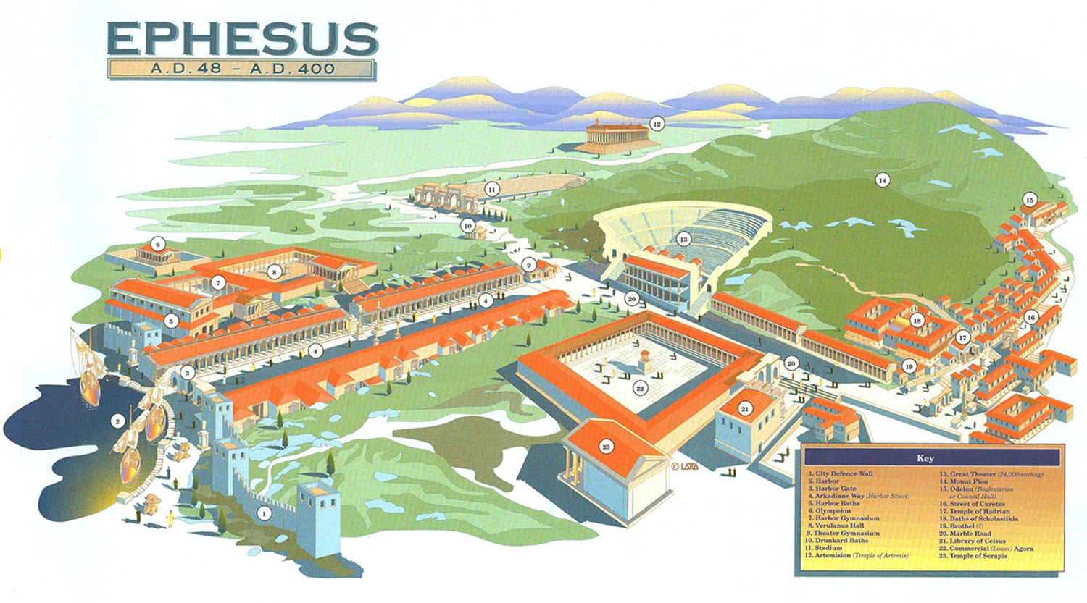
The City of Ephesus
Temple of Artemis
Stadium
Amphitheatre
Agora
Library
HARBOR

Slide 10
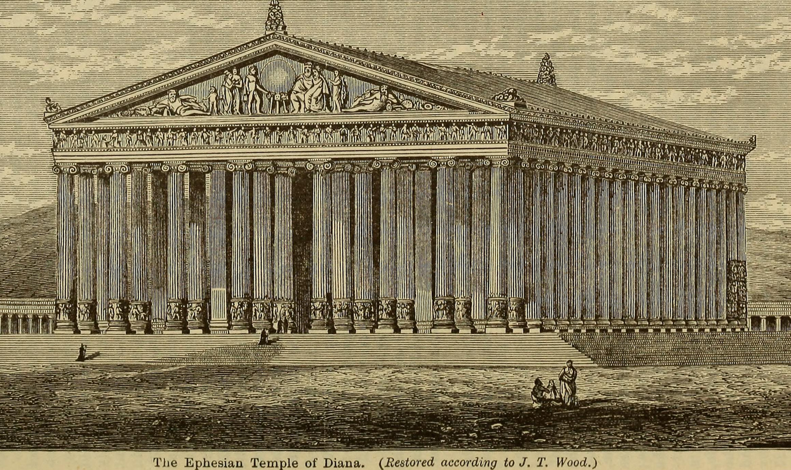
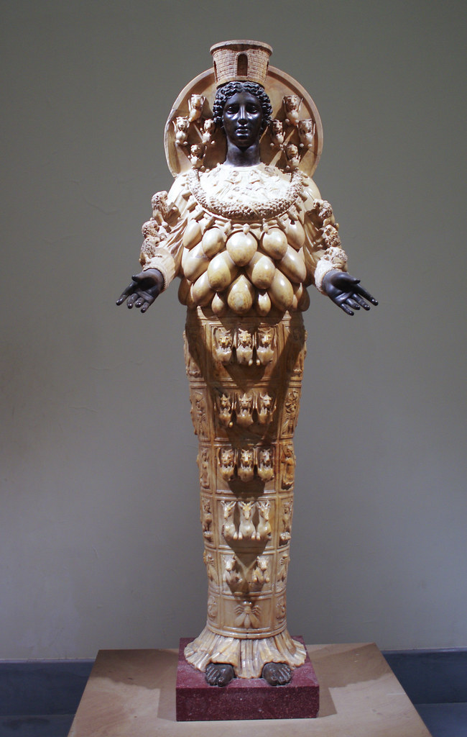
The City of Ephesus
The temple of Artemis (Diana)

Slide 11
The Church in Ephesus Revelation 2:1
Paul stopped there briefly in AD 51 leaving Aquilla & Pricilla who began planting a church there (Acts 18)
Paul returned in ~ late AD 51 & taught there 2 years, 3 months - a very strong church developed

Slide 12
The Church in Ephesus Revelation 2:1
Paul wrote his letter to them in AD 61. Ministers included Timothy, Onesiphorus, Tychicus & later John
Revelation 2:1-7 is written ~ AD 95, 44 years since its founding and 34 years since Paul’s letter to them

Slide 13
The Author Revelation 2:1
It is to the angel / messenger of the church in Ephesus
A human representing the church & taking letter to it
Jesus Christ is the speaker
The descriptions in 2:1 match those in 1:12, 13 & 16

Slide 14
The Author Revelation 2:1
Jesus is walking among the 7 lampstands / churches and He has a firm hold on the 7 stars / messengers

Slide 15
The Commendation Revelation 2:2-3
Jesus has complete knowledge of His churches - (Jer. 17:10; Luke 6:8)
Deeds / works - general term for the things they actively did
Toil / labor expresses exertion done to the point of exhaustion / weariness as if beaten

Slide 16
The Commendation Revelation 2:2-3
Perseverance is a steadfastness to continue to bear up in difficult circumstances
They would not tolerate evil / bad men - those of low moral character, worthless, godless

Slide 17
The Commendation Revelation 2:2-3
The put self-professing “apostles” (special messenger sent with authority) to the test & found them false
Upholding Jesus’ name brought them persecution, but they persevered and did not become weary

Slide 18
The Condemnation Revelation 2:4
They left / let go of / set aside / ceased from the first love they had for Christ
First love refers to the initial love when first saved - comparable to initial love for “wife of one’s youth”
A first love should grow over time including its emotional component

Slide 19
The Condemnation Revelation 2:4
Neglect / lack of nurture results in the relationship becoming rote and the love stale & cold.
The Ephesians were noted in the past for their love (Eph. 1:15) as true disciples of Jesus (John 13:35)

Slide 20
The Cure Revelation 2:5
Remember from where you have fallen - recall to mind where you once stood - commitment & emotion
Repent - change your mind and belief resulting in a change of action

Slide 21
The Cure Revelation 2:5
[Re]do the deeds you did at first - go back and do again the deeds of when you first loved
If there was not repentance and the love rekindled, Jesus would remove their lampstand - they not exist

Slide 22
The Complement Revelation 2:6
They lost their first love, but not their hatred for the deeds of evil
The Nicolaitans were a licentious, antinomian heretical sect that promoted syncretism with pagans

Slide 23
The Charge Revelation 2:7
This command makes the principles expressed in the letter applicable to all Christians
Follow the good example of the Ephesians & take to heart the warning to Remember, Repent, Redo

Slide 24
The Charge Revelation 2:7
All true Christians overcome sin by faith in Christ & gain future access to the Tree of Life - Rev. 22:1-2

Slide 25
Grace Bible Church Glorifying God by Making Disciples of Jesus Christ

