Slide 1
Grace Bible Church Glorifying God by Making Disciples of Jesus Christ

Slide 2
A reminder to consider others Please:
Silence your cell phone & all electronic devices
Use the nursery or cry room if your child is fussy
Get up during the preaching only if absolutely necessary (please sit in back if you must leave early)
Refrain from eating & drinking during worship service (except medical needs)
Notes:
2

Slide 3
Laodicea: The Lukewarm Church Revelation 3:14-22
Each of the 7 letters is worth the time to examine, consider & apply by every Christian & church

Slide 4
Review Revelation 2:1 – 3:13
Ephesus: Commended for deeds, doctrine & moral judgment, but left first love: Remember, Repent, Redo
Smyrna: Severely oppressed by Pagan society so impoverished, but rich in things of God: Remain faithful

Slide 5
Review Revelation 2:1 – 3:13
Pergamum: Severely oppressed including martyrdom, but tolerated false doctrine: Repent
Thyatira: Increased love, faith, service & perseverance, but tolerated false teacher & doctrine: Repent

Slide 6
Review Revelation 2:1 – 3:13
Sardis: Spiritually dead: The few cells alive to strengthen, be alert, remember, keep, repent
Philadelphia: Commended without any correction. Promises of provision and protection.

Slide 7
The Letter to the Church at Laodicea Revelation 3:14-22

Slide 8
The Recipient Revelation 3:14a
The angel - a human messenger - to the church in Laodicea

Slide 9
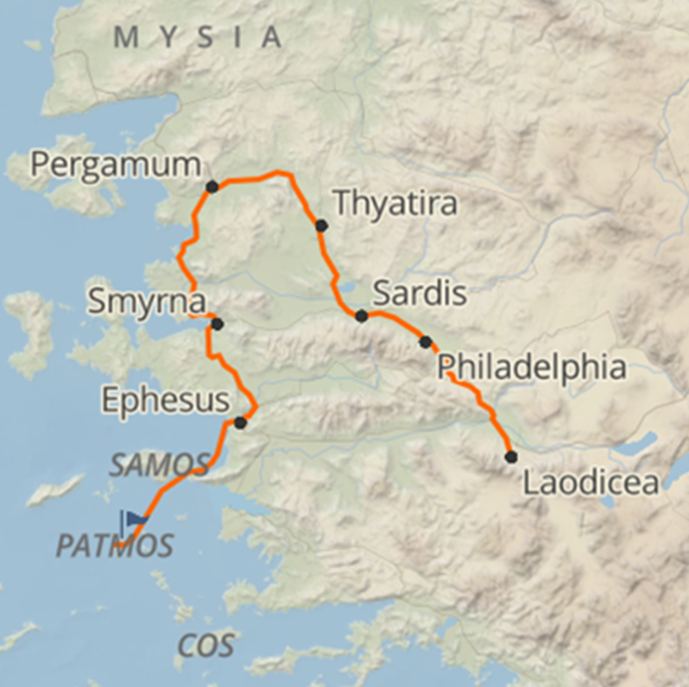
The City of Laodicea
Located in Lycus valley ~100 east of Ephesus, ~40 miles southeast of Philadelphia, on major trade route

Slide 10
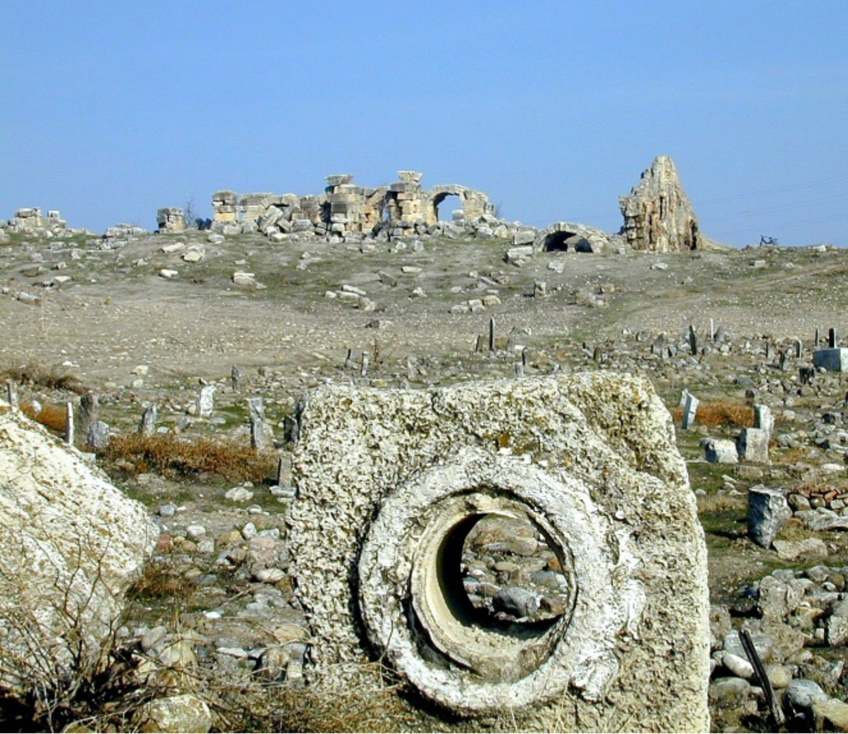
The City of Laodicea
Defensible location except for need to import water via aqueduct - it arrived tepid
Laodicean pipe piece with bath-
house in background

Slide 11
The City of Laodicea
Founded before 253 B.C. by Antiochus II & named after his wife.
A mix of populations, cultures and religions

Slide 12
The City of Laodicea
Judicial seat of district
Very wealthy
A commercial, financial and manufacturing center:
Major exports:
Soft, glossy black wool & clothing
Medicines - especially eye salve

Slide 13
The City of Laodicea
Probably founded by Epaphras c. 53-57
Paul was aware & wrote to them, but he had not been there
Safe to assume that problems addressed in Ephesians & Colossians were also issues in Laodicea

Slide 14
The Author Revelation 3:14b
The Amen - used as a title / personal name for Jesus.
Amen means fixed, true, unchangeable implies certainty, verity
The faithful & true Witness –

Slide 15
The Author – The Faithful & True Witness Revelation 3:14b
Legal: Jesus has legal standing in all things for all created through & for Him
Historical: Being eternal & omniscient He is true witness for all things before, throughout and after time
Ethical: Jesus’ witness is always full & true without any deception

Slide 16
The Author Revelation 3:14b
The Beginning of the creation of God - not a created being but the “originator” of all creation
The living one (Rev. 1:8) who is the “I Am” being one with the Father (John 8:58; 10:30), the Alpha & Omega, First & Last, Beginning & End (Rev. 22:13), the source of creation not a result of it.

Slide 17
The Author Revelation 3:14b
These titles & descriptions parallel corrections to false doctrine warned about in Ephesians & Colossians

Slide 18
The Assessment & Promises Revelation 3:15
Jesus’ Knowledge:
Jesus has full knowledge of their past and present for He is omniscient
Jesus knows all the deeds they did - and what they did not do.

Slide 19
The Assessment & Promises Revelation 3:15
Jesus’ assessment:
They were neither cold nor hot
Colossae had cold water.
Heiroplis had springs of hot water.
Laodicea had tepid, lukewarm water

Slide 20
The Assessment & Promises Revelation 3:15
Jesus’ wish is that they were either cold or hot for the extremes were better than being lukewarm
Hot refers to being fervent in spirit like Apollos (Acts 18:25-26) or Christians are supposed to be (Romans 12:11)

Slide 21
The Assessment & Promises Revelation 3:15
Cold is the opposite - Rejecting the gospel and not wanting to hear any more
Being lukewarm is a very serious condition for there is greater hope for the cold

Slide 22
The Actions Promised Revelation 3:16-17
Jesus warns the visceral reaction to what is lukewarm is to vomit it out - which was about to happen to them
There is hope given for that had not yet happened due to God’s longsuffering nature

Slide 23
The Actions Promised Revelation 3:16-17
Their great wealth blinded them to their need - they were the opposite of the church in Smyrna
Wretched: deplorably bad state - Romans 7:24.
Miserable: a condition to be pitied - 1 Cor. 15:9

Slide 24
The Actions Promised Revelation 3:16-17
Poor: destitute as in James 2:2 wearing ragged clothes.
Blind: without the ability to see
Naked: No clothes
The lukewarm are professing Christians whose hearts are not set on Christ to believe or walk with Him

Slide 25
The Advice Revelation 3:18
Jesus advises them to buy what cannot be purchased with material wealth - see Isaiah 55:1-3
Fire purifies gold. Faith, which is more precious, is the gold here (1 Peter 1:7) & is refined by trial (James 1:3-4)
True faith would solve being spiritually wretched, miserable & poor

Slide 26
The Advice Revelation 3:18
White garments relates to purity & in Revelation is righteousness imputed to the Saints who live accordingly
To actually believe and walk in faith with Jesus solves their problem of being spiritually naked

Slide 27
The Advice Revelation 3:18
The eye salve here is the Holy Spirit (1 John 2:20) removing spiritual blindness enabling belief in the gospel (2 Corinthians 4:1-6)

Slide 28
The Command Revelation 3:19
An abrupt change from the previous warning revealing God’s longsuffering love even to the lukewarm
qilevw / phileo, the love of personal affection
Out of love God reproves (correcting by words) & disciplines (correct by action - chasten)

Slide 29
The Command Revelation 3:19
The Holy Spirit convicts (reproves) the world (John 16:8) & those in opposition / sin are chastened (2 Tim 2:25)
They were to be zealous (become hot) to repent (change belief resulting in living a life of faith in Christ)

Slide 30
The Plea & Promise Revelation 3:20
A beautiful illustration of Jesus standing, knocking & calling for the door to be opened - but He is outside!
The promise to dine is one of close, personal fellowship
The promises are both immediate and eschatological

Slide 31
The Overcomer Revelation 3:21
The overcomer, the true Christian, will rule with Christ in His millennial kingdom

Slide 32
The Call to All Revelation 3:22
The principles in the letter apply to Christians and churches throughout time

Slide 33
Conclusions
Every letter continues to be relevant to every Christian or church of similar character or situations
Be encouraged by the commendations, take to heart the condemnations & warnings, hope in the promises

Slide 34
Conclusions
Overcomers rejoice in Jesus’ promises
Marriage supper of the Lamb
Reign with Christ
Name in book of life / no 2nd death
In New Jerusalem,
Fellowship with God & worship Him
Eat of tree of life in garden of God

Slide 35
Conclusions
You can become an overcomer by turning from your sin & self to believe & trust the Savior, Jesus Christ

Slide 36
Grace Bible Church Glorifying God by Making Disciples of Jesus Christ

